Slide 1
Team 3: Adding Features to Pong
David Berry
Abigail Blevins
Shantel Walker

Slide 2
Accomplishments
Downloaded, studied, added comments to Original game.
Created 2 Variations, each with different added features
1 - Added 2nd Ball –
Play with 2 balls going at once
2 - Added Paddles to top and bottom of screen
Each Player controls one side Paddle and one top or bottom paddle
Created Several Enhancements to Original and New Features:
Screen Color
Ball Color
Paddle Color
Start by Key Tap
Improved key placement
Sound Effects

Slide 3
Summary of Revisions
Rev 0 - Original game downloaded
Rev 1 - Added a second ball, changed screen color
Rev 2a - Added paddles to top and bottom, changed paddle color
rev 3c - Changed keys for top and bottom paddles and added start by hitting "e" and stop play after score.
rev 3d - Removed quit and stopplay - made play too jerky
rev 4 - Added sound effects
rev 4a - Removed sound effects - made game hesitate too much
Rev 5 - Made balls the same color - fixed screen flashing

Slide 4
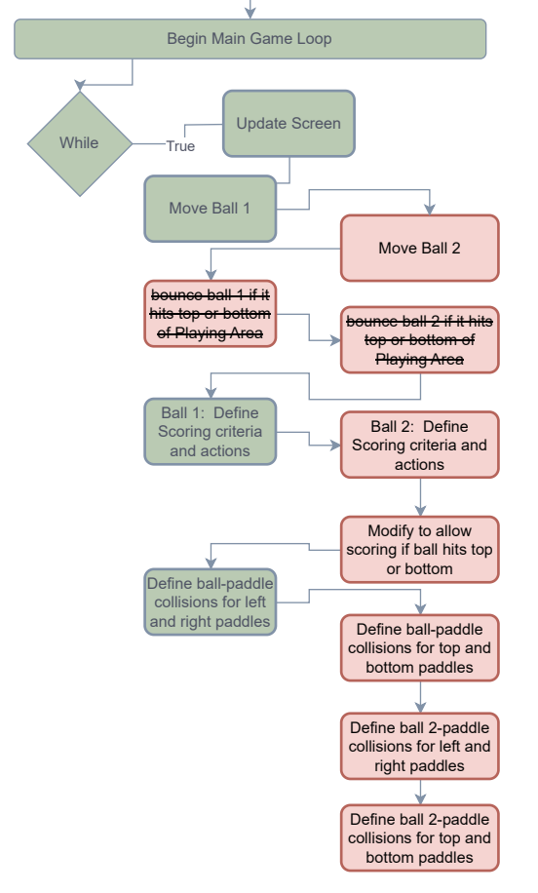
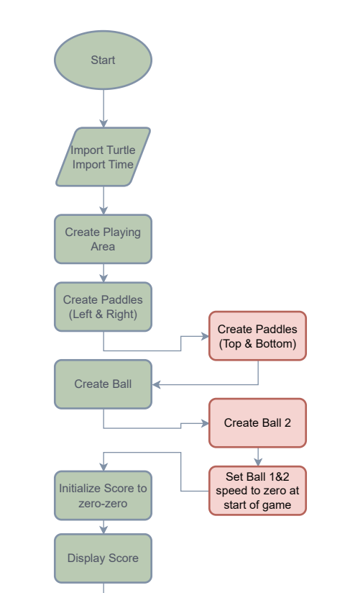
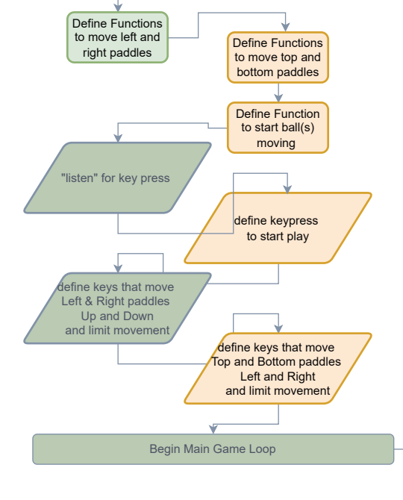
Flow Chart

Slide 5
Coding Examples

Slide 6
# top paddle: copy left_pad and change left to top
top_pad = turtle.Turtle() # rev 2
top_pad.speed(0) # rev 2
top_pad.shape("square") # rev 2
top_pad.color("red") # rev 2: change black to red
top_pad.shapesize(stretch_wid=2, stretch_len=6) # rev 2: swap wid and len
top_pad.penup() # rev 2
top_pad.goto(0, 200) # rev 2: from -400,0 to 0,200
(-500, 300)
# Create screen
sc = turtle.Screen()
sc.title("Pong game")
sc.bgcolor("blue")
sc.setup(width=1000, height=600)
(0, 300)
(500, 300)
(0, 200)
(400, 0)
120
20
(-500, 0)
(0, 0)
(500, 0)
(-400, 0)
# Ball of circle shape
hit_ball = turtle.Turtle()
hit_ball.speed(4) # Adjusted speed
hit_ball.shape("circle")
hit_ball.color("white")
hit_ball.penup()
hit_ball.goto(0, 0)
# Ball2 of circle shape
hit_ball2 = turtle.Turtle()
hit_ball2.speed(4) # Adjusted speed
hit_ball2.shape("circle")
hit_ball2.color("black")
hit_ball2.penup()
hit_ball2.goto(0, 0)
(0, -200)
40
# Left paddle
left_pad = turtle.Turtle()
left_pad.speed(0)
left_pad.shape("square")
left_pad.color("black")
left_pad.shapesize(stretch_wid=6, stretch_len=2)
left_pad.penup()
left_pad.goto(-400, 0)
(-500, -300)
(0, -300)
(500, -300)

Slide 7
(-500, 300)
(0, 300)
(500, 300)
Paddle Movement
def paddleaup():
y = left_pad.ycor()
if y < 250: # Limit paddle movement
y += 20
left_pad.sety(y)
def paddleadown():
y = left_pad.ycor()
if y > -240: # Limit paddle movement
y -= 20
left_pad.sety(y)
# Keyboard bindings
sc.listen()
sc.onkeypress(paddleaup, "w") # Changed to 'w'
sc.onkeypress(paddleadown, "s") # Changed to 's'
(400, 0)
120
20
(-500, 0)
(0, 0)
(500, 0)
(-400, 0)
40
(-500, -300)
(0, -300)
(500, -300)

Slide 8
Main Game Loop (Example code)
Screen Refresh
sc.update()
time.sleep(0.01) # Add delay to make game smoother
Ball Movement (ball 1)
hit_ball.setx(hit_ball.xcor() + hit_ball.dx)
hit_ball.sety(hit_ball.ycor() + hit_ball.dy)
Scoring (ball 1)
if hit_ball.xcor() > 500 or hit_ball.ycor() < -300: # rev 2: added "or hit_ball.ycor() < -300"
hit_ball.goto(0, 0)
hit_ball.dy *= -1
left_player += 1
Ball / Paddle Collision (ball 1 and right paddle)
if (hit_ball.xcor() > 360 and hit_ball.xcor() < 370) and \
(hit_ball.ycor() < right_pad.ycor() + 50 and hit_ball.ycor() > right_pad.ycor() - 50):
hit_ball.setx(360)
hit_ball.dx *= -1

Slide 9
Conclusions
Created 2 Variations of Pong, with added features
2nd Ball
Paddles on top and bottom of screen
Created Several Enhancements to Features:
Object Color
Improved flow and key placement
Sound Effects (Worked but caused delay in game play)

Slide 10
Possible Forward Work
Enable user to stop play and get out of infinite loop in original game
Allow User to choose between enhancements
Regular mode, 2 balls and 2 paddles, or 2 balls and 4 paddles
Allow User to choose score to play to
Look into delay caused by system sound

